Slide 1
IMPLEMENTING THE PHASES OF A COMPILER
Course Faculty:
DR.michael
CSA1461/ COMPILER DESIGN
Work Done:
D.Niswitha -192211496
B. Soujanya -192211752
v. Vaishnavi-192211502

Slide 2
Contents
Abstract
Introduction
Problem Statement
WHY Used?
Proposes
Methods
Examples
How Bug Created
Frontend
Backend
UI Design
Layout Design
Feasible Elements Used
Conclusion

Slide 3
ABSTRACT
Lexical analyser: This phase involves breaking down the input source code into tokens or lexemes, identifying keywords, identifiers, operators, and literals. In our project, this phase will be pivotal in handling the limited input size efficiently, ensuring accurate tokenization within the specified constraints. Syntax Analysis: Syntax analysis verifies the structure of the source code based on the grammar rules of the programming language. With a focus on a maximum input size of 6 elements, this phase becomes critical in detecting and reporting any syntactic errors within the limited code space. Semantic Analysis: Semantic analysis checks the meaning and consistency of the code. Despite the small input size, this phase remains essential for detecting semantic errors and ensuring the correctness of the program logic within the defined constraints . Intermediate Code Generation: This phase involves generating an intermediate representation of the source code, which simplifies subsequent optimization and code generation stages. Despite the restricted input size, generating an intermediate code is valuable for maintaining modularity and facilitating optimization. Code Optimization: Optimization techniques aim to improve the efficiency and performance of the generated code. Even with a limited input size, applying optimization strategies can enhance the execution speed and resource utilization of the compiled program. Code Generation: The final phase translates the optimized intermediate code into executable machine code suitable for the target platform. Adhering to the constraint of a maximum input size of 6 elements, this phase ensures the generation of compact and efficient machine code

Slide 4
INTRODUCTION:
One essential compiler improvement that has a big influence on produced code speed is register allocation. The goal of register allocation is to reduce the amount of intermediate values that must be stored in memory by mapping program variables to a restricted number of hardware registers. Since accessing registers on current CPUs is much quicker than accessing memory.
A difficult optimization problem is efficient register allocation, especially for architectures with few registers and intricate instruction sets. The objective is to reduce the amount of register spills and fills, which happen when a scarcity of registers forces a variable to be temporarily stored in memory. The register allocation problem has been approached using a variety of techniques, from straightforward heuristics to complex graph colouring algorithms. This work provides a comprehensive analysis of effective register allocation strategies, emphasizing new methods that overcome the drawbacks of the state of the matter.

Slide 5
Problem Statement
The project involves designing a compiler system encompassing all essential phases, from lexical analysis to code generation, tailored to handle inputs with a maximum length of 6 elements. The design must prioritize simplicity, efficiency, and adaptability to the constrained input size. Input Size Constraint: The compiler must be capable of processing source code inputs containing a maximum of 6 elements. This constraint adds complexity to the compilation process, requiring meticulous handling of tokenization, parsing, and code generation within the limited code space. Translation to Executable Code: The ultimate goal is to translate the source code into executable machine code that can be run on a target platform. Despite the restriction on input size, the compiler must ensure the generation of correct and optimized machine code suitable for execution.
Educational Value: Developing a compiler under constraints provides a hands-on learning experience for understanding compiler design principles, including lexical analysis, parsing, semantic analysis, optimization, and code generation. Practical Application: While the input size constraint may seem artificial, it simulates scenarios where memory or processing power is limited, such as embedded systems or constrained environments. The skills gained from this project are transferable to real-world compiler optimization challenges. Research Potential: Exploring compiler design under constraints can lead to insights into optimizing compiler performance, resource utilization, and code efficiency in resource-constrained environments.

Slide 6
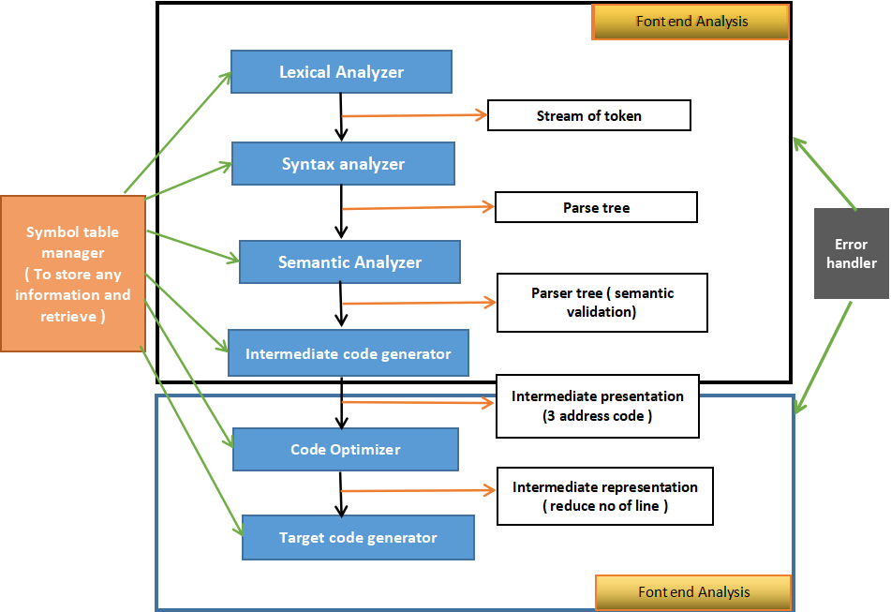
ARCHITECTURE

Slide 7
WHY PHASES OF COMPILER?
Modularity and Maintainability
Optimization Opportunities
Portability
Error Detection and Reporting
Understanding and Teaching

Slide 8
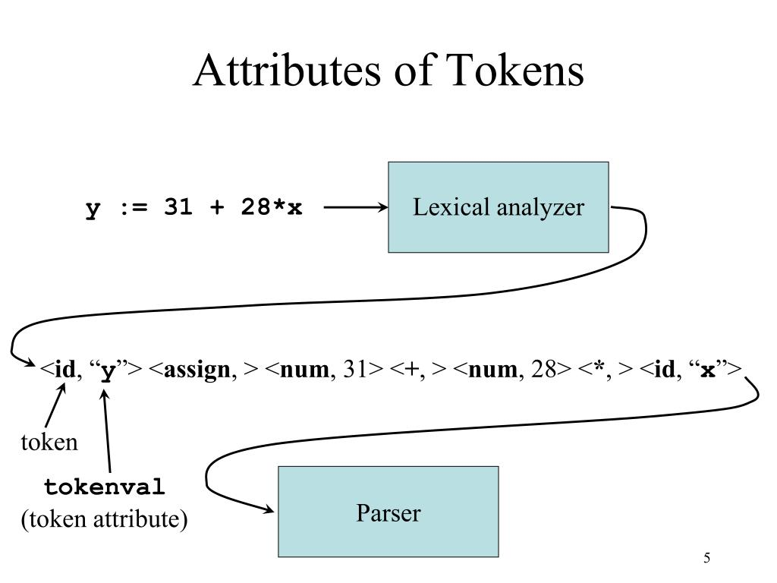
Lexical Analysis (Scanner)
Develop a scanner that reads the input source code character by character and recognizes tokens based on predefined lexical rules.

Slide 9

Syntax Analysis (Parser)
Construct a parser that analyzes the syntactic structure of the input source code and builds a parse tree or abstract syntax tree

Slide 10

Semantic Analysis
Develop semantic analysis routines to check the meaning of the source code beyond its syntax.

Slide 11
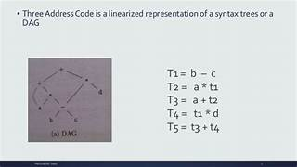
Intermediate Code Generation
Generate an intermediate representation (IR) of the source code that is closer to machine code but still platform-independent.

Slide 12
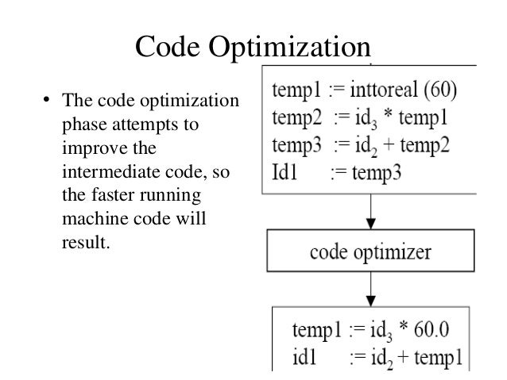
CODE Optimization
Improve the efficiency and performance of the intermediate code through various optimization techniques.

Slide 13
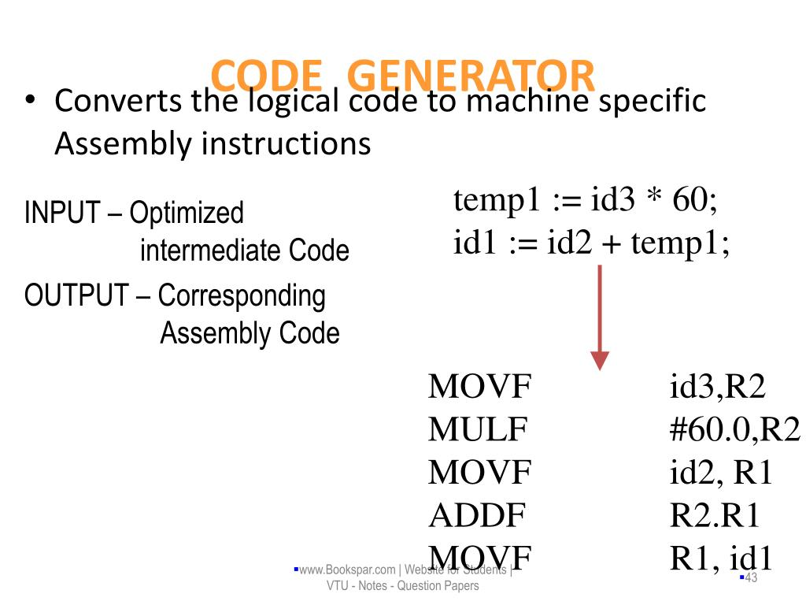
Code Generation
Translate the optimized intermediate code into executable machine code for the target architecture.

Slide 14
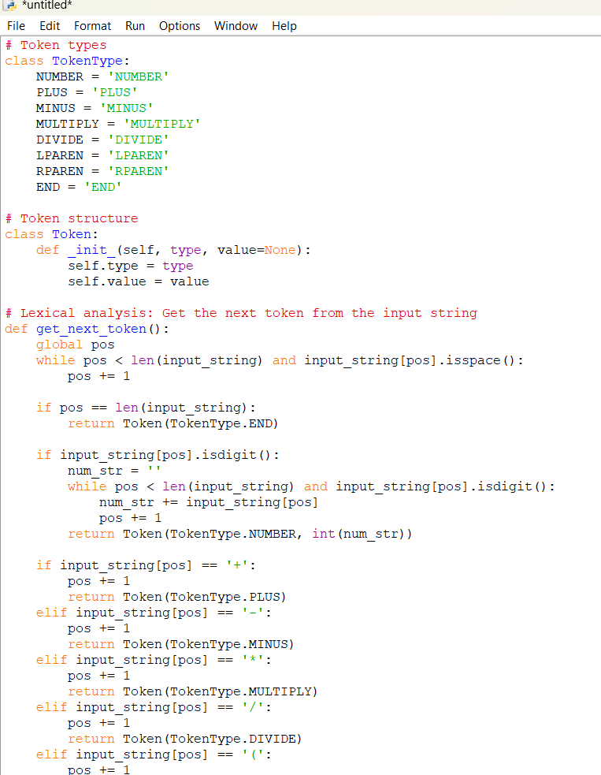
CODE

Slide 15
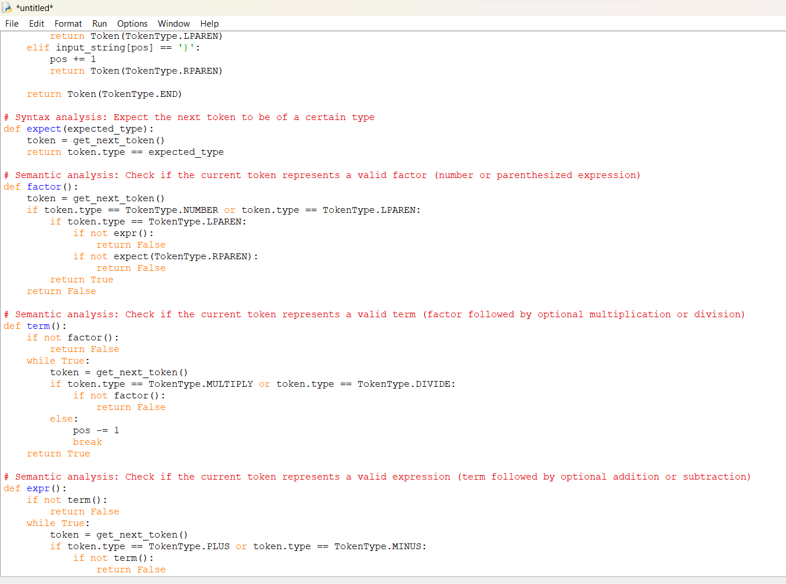

Slide 17
CONCLUSION
In conclusion, the design and implementation of a compiler system tailored to handle inputs with a maximum size of 6 elements present a unique challenge that emphasizes the importance of efficiency, precision, and optimization in each phase of compilation. Through this capstone project, we have explored the intricacies of compiler design and highlighted the significance of adapting compiler principles to constrained environments. The problem statement centred around developing a simplified compiler system capable of translating source code into executable machine code within the constraints of limited input size. By clearly defining the problem, we identified the key components, objectives, and significance of the project, laying the groundwork for the proposed. The proposed design outlined the essential phases of compilation, including lexical analysis, syntax analysis, semantic analysis, intermediate code generation, code optimization, and code generation, tailored to the 6-element input constraint. Each phase was designed to prioritize simplicity, efficiency, and adaptability, ensuring the generation of correct and optimized executable code. Additionally, the

